Slide 1
Software Quality Assurance and Testing Lecture - 04
ABDUS SATTER
LECTURER
INSTITUTE OF INFORMATION TECHNOLOGY
UNIVERSITY OF DHAKA

Slide 2
Dynamic Testing
BLACK BOX TESTING TECHNIQUES

Slide 3
Boundary Value Analysis (BVA)
An effective test case design requires test cases to be designed such that they maximize the probability of finding errors. BVA technique addresses this issue. With the experience of testing team, it has been observed that test cases designed with boundary input values have a high chance to find errors. It means that most of the failures crop up due to boundary values.
BVA is considered a technique that uncovers the bugs at the boundary of input values. Here, boundary means the maximum or minimum value taken by the input domain. For example, if A is an integer between 10 and 255, then boundary checking can be on 10(9,10,11) and on 255(256,255,254). Similarly, B is another integer variable between 10 and 100, then boundary checking can be on 10(9,10,11) and 100(99,100,101)

Slide 4
Boundary Value Checking (BVC)
In this method, the test cases are designed by holding one variable at its extreme value and other variables at their nominal values in the input domain.
The variable at its extreme value can be selected at:
Minimum value (Min)
Value just above the minimum value (Min⁺)
Maximum value (Max)
Value just below the maximum value (Max⁻)

Slide 5
Boundary Value Checking (BVC)
Let us take the example of two variables, A and B. If we consider all the above combinations with nominal values, then following test can be designed:
A_{nom}, B_{min}
A_{nom}, B_{min+}
A_{nom}, B_{max}
A_{nom}, B_{max–}
A_{min}, B_{nom}
A_{min+}, B_{nom}
A_{max}, B_{nom}
A_{max–}, B_{nom}
A_{nom}, B_{nom}

Slide 6
Robustness Testing Method
The idea of BVC can be extended such that boundary values are exceeded as:
value just greater than the Maximum value (Max⁺)
value just less than Minimum value (Min⁻)
When test cases are designed considering the above points in addition to BVC, it is called robustness testing.

Slide 7
Robustness Testing Method
A_{nom}, B_{min}
A_{nom}, B_{min+}
A_{nom}, B_{max}
A_{nom}, B_{max–}
A_{min}, B_{nom}
A_{min+}, B_{nom}
A_{max}, B_{nom}
A_{max–}, B_{nom}
A_{nom}, B_{nom}
A_{max+}, B_{nom}
A_{min–}, B_{nom}
A_{nom,} B_{max+}
A_{nom}, B_{min–}

Slide 8
Worst-Case Testing Method
We can again extend the concept of BVC by assuming more than one variable on the boundary. It is called worst-case testing method.
A_{min+},B_{max}
A_{min}, B_{max–}
A_{min+}, B_{max–}
A_{max}, B_{max}
A_{max–}, B_{max}
A_{max}, B_{max–}
A_{max–}, B_{max–}
A_{nom}, B_{min}
A_{nom}, B_{min+}
A_{nom}, B_{max}
A_{nom}, B_{max–}
A_{min}, B_{nom}
A_{min+}, B_{nom}
A_{max}, B_{nom}
A_{max–}, B_{nom}
A_{nom}, B_{nom}
A_{min}, B_{min}
A_{min+}, B_{min}
A_{min}, B_{min+}
A_{min+}, B_{min+}
A_{max}, B_{min}
A_{max–}, B_{min}
A_{max}, B_{min+}
A_{max–}, B_{min+}
A_{min}, B_{max}

Slide 9
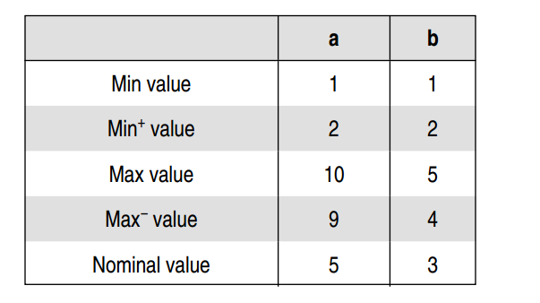
Example
A program computes a^b where a lies in the range [1,10] and b within [1,5]. Design test cases for this program using BVC, robust testing, and worst-case testing methods.

Slide 10
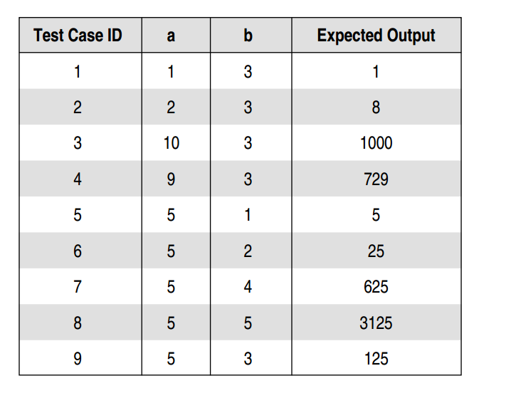
BVC

Slide 11
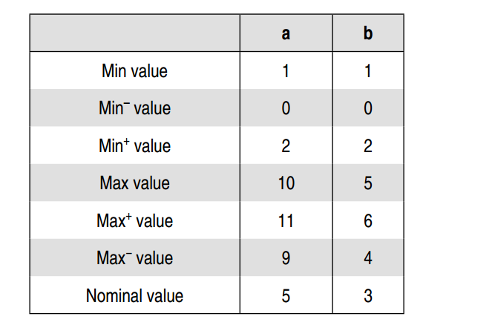
Robust Testing

Slide 12
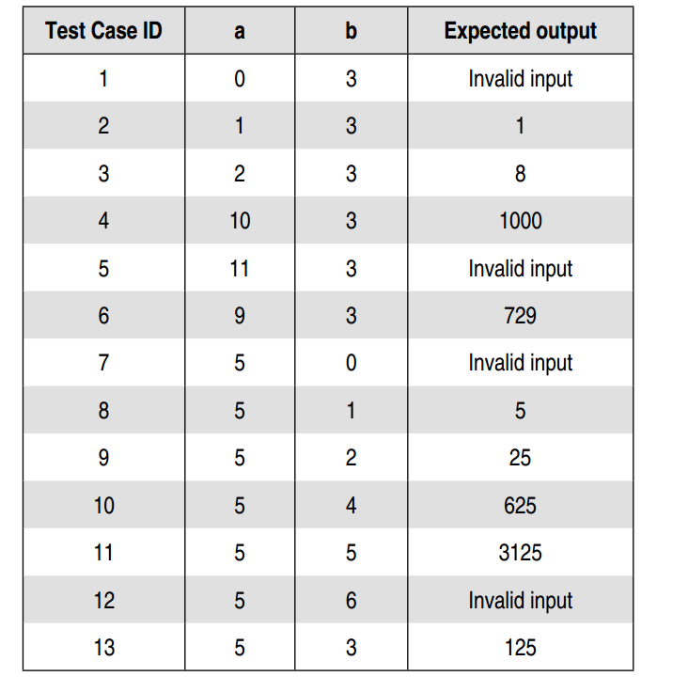
Robust Testing

Slide 13
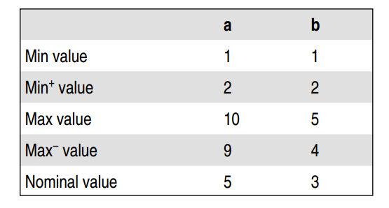
Worst Testing

Slide 14
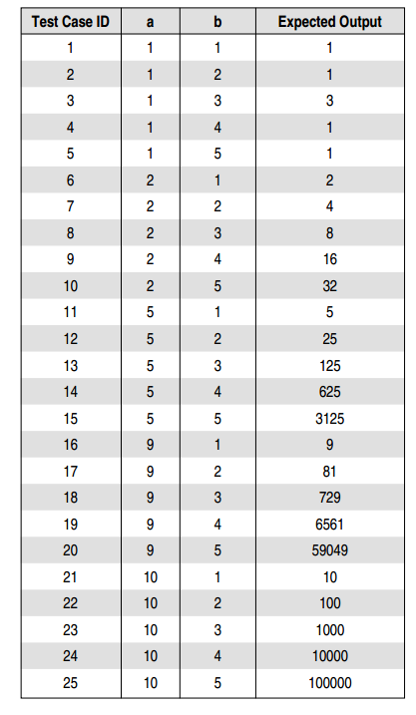
Worst Testing

Slide 15
Equivalence Class Testing
We know that the input domain for testing is too large to test every input. So we can divide or partition the input domain based on a common feature or a class of data. Equivalence partitioning is a method for deriving test cases where in classes of input conditions called equivalence classes are identified such that each member of the class causes the same kind of processing and output to occur.

Slide 16
Equivalence Class Testing
Equivalence partitioning method for designing test cases has the following goals:
Completeness: Without executing all the test cases, we strive to touch the completeness of testing domain.
Non-redundancy: When the test cases are executed having inputs from the same class, then there is redundancy in executing the test cases. Time and resources are wasted in executing these redundant test cases, as they explore the same type of bug. Thus, the goal of equivalence partitioning method is to reduce these redundant test cases.

Slide 17
Identification Of Equivalent Classes
Two types of classes can always be identified :
Valid equivalence classes: These classes consider valid inputs to the program.
Invalid equivalence classes: One must not be restricted to valid inputs only. We should also consider invalid inputs that will generate error conditions or unexpected behavior of the program

Slide 18
Guidelines for Forming Equivalence Classes
If there is no reason to believe that the entire range of an input will be treated in the same manner, then the range should be split into two or more equivalence classes.
If a program handles each valid input differently, then define one valid equivalence class per valid input.
Boundary value analysis can help in identifying the classes. For example, for an input condition, say 0 ≤ a ≤100, one valid equivalent class can be formed from the valid range of a. And with BVA, two invalid classes that cross the minimum and maximum values can be identified, i.e. a <0 and a >100.

Slide 19
Guidelines for Forming Equivalence Classes
If an input variable can identify more than one category, then for each category, we can make equivalent classes. For example, if the input is a character, then it can be an alphabet, a number, or a special character. So we can make three valid classes for this input and one invalid class.
If an input condition specifies a ‘must be’ situation (e.g., ‘first character of the identifier must be a letter’), identify a valid equivalence class (it is a letter) and an invalid equivalence class (it is not a letter).

Slide 20
Guidelines for Forming Equivalence Classes
Equivalence classes can be of the output desired in the program. For an output equivalence class, the goal is to generate test cases such that the output for that test case lies in the output equivalence class. Determining test cases for output classes may be more difficult, but output classes have been found to reveal errors that are not revealed by just considering the input classes.

Slide 21
Guidelines for Forming Equivalence Classes
Look for membership of an input condition in a set or group and identify valid (within the set) and invalid (outside the set) classes. For example, if the requirements state that a valid province code is ON, QU, and NB, then identify: the valid class (code is one of ON, QU, NB) and the invalid class (code is not one of ON, QU, NB).

Slide 22
Guidelines for Forming Equivalence Classes
If the requirements state that a particular input item match a set of values and each case will be dealt with differently, identify a valid equivalence class for each element and only one invalid class for values outside the set. For example, if a discount code must be input as P for a preferred customer, R for a standard reduced rate, or N for none, and if each case is treated differently, identify: the valid class code = P, the valid class code = R, the valid class code = N, the invalid class code is not one of P, R, N.

Slide 23
Guidelines for Forming Equivalence Classes
If an element of an equivalence class will be handled differently than the others, divide the equivalence class to create an equivalence class with only these elements and an equivalence class with none of these elements. For example, a bank account balance may be from 0 to Rs 10 lakh and balances of Rs 1,000 or more are not subject to service charges. Identify: the valid class: (0 ≤balance <Rs 1,000), i.e. balance is between 0 and Rs 1,000 – not including Rs 1,000; the valid class: (Rs 1,000 ≤ balance ≤Rs 10 lakh, i.e. balance is between Rs 1,000 and Rs 10 lakh inclusive the invalid class: (balance <0) the invalid class: (balance >Rs 10 lakh).

Slide 24
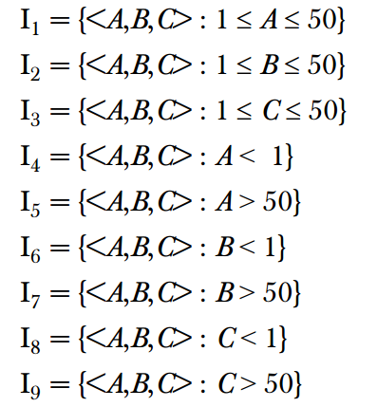
Example
A program reads three numbers, A, B, and C, with a range [1, 50] and prints the largest number. Design test cases for this program using equivalence class testing technique.

Slide 25
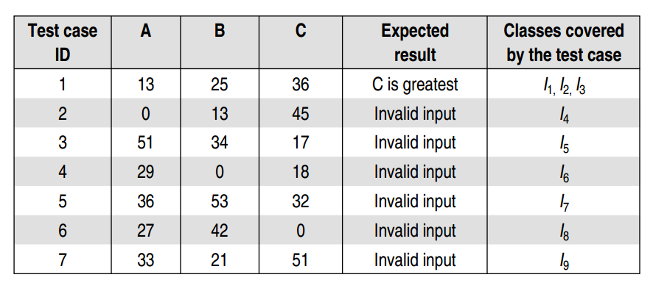
Example

Slide 26
State Table-based Testing
A system or its components may have a number of states depending on its input and time. For example, a task in an operating system can have the following states:
New State: When a task is newly created.
Ready: When the task is waiting in the ready queue for its turn.
Running: When instructions of the task are being executed by CPU.
Waiting: When the task is waiting for an I/O event or reception of a signal.
Terminated: The task has finished execution.

Slide 27
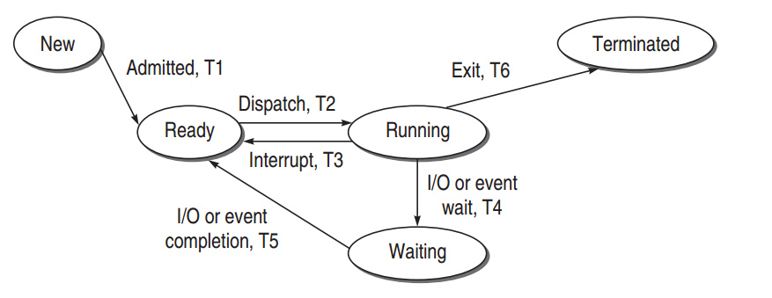
State Graph

Slide 28
The Resulting Output From A State
T0 = Task is in new state and waiting for admission to ready queue
T1 = A new task admitted to ready queue
T2 = A ready task has started running
T3 = Running task has been interrupted
T4 = Running task is waiting for I/O or event
T5 = Wait period of waiting task is over
T6 = Task has completed execution

Slide 29
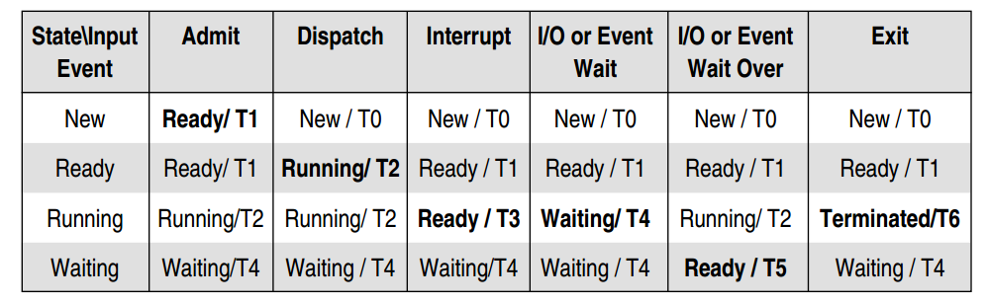
State Table

Slide 30
State Table-based Testing
Identify the states
Prepare state transition diagram after understanding transitions between states
Convert the state graph into the state table as discussed earlier
Analyze the state table for its completeness
Create the corresponding test cases from the state table

Slide 31
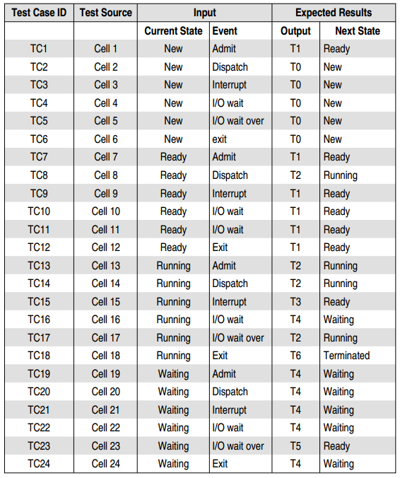
State Table-based Testing

Slide 32
Decision Table-based Testing
Boundary value analysis and equivalence class partitioning methods do not consider combinations of input conditions. These consider each input separately. There may be some critical behavior to be tested when some combinations of input conditions are considered.
Decision table is another useful method to represent the information in a tabular method. It has the specialty to consider complex combinations of input conditions and resulting actions. Decision tables obtain their power from logical expressions. Each operand or variable in a logical expression takes on the value, TRUE or FALSE.

Slide 33
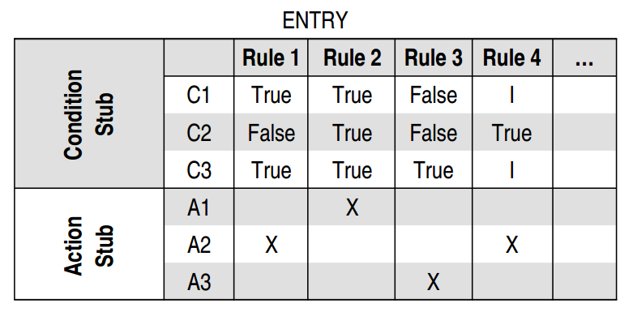
Decision Table Structure

Slide 34
Test Case Design Using Decision Table
For designing test cases from a decision table, following interpretations should be done:
Interpret condition stubs as the inputs for the test case.
Interpret action stubs as the expected output for the test case.
Rule, which is the combination of input conditions, becomes the test case itself.

Slide 35
Example
A program calculates the total salary of an employee with the conditions that if the working hours are less than or equal to 48, then give normal salary. The hours over 48 on normal working days are calculated at the rate of 1.25 of the salary. However, on holidays or Sundays, the hours are calculated at the rate of 2.00 times of the salary. Design test cases using decision table testing.

Slide 36
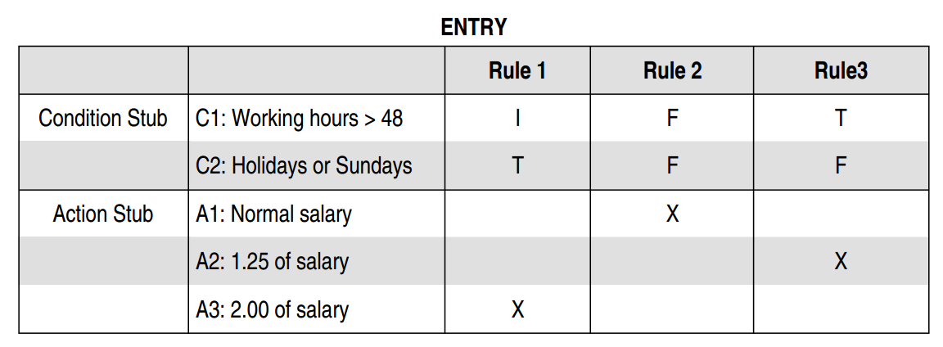
Example

Slide 37
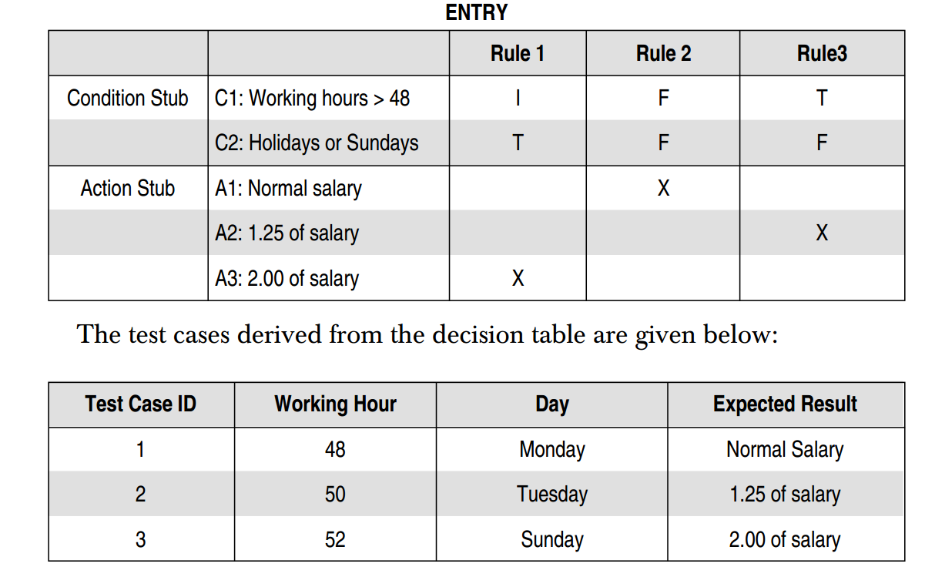
Example

Slide 38
Cause-effect Graphing Based Testing
The Cause and Effect Graph is a dynamic test case writing technique. Here causes are the input conditions and effects are the results of those input conditions.
Cause-Effect Graph is a technique that starts with a set of requirements and determines the minimum possible test cases for maximum test coverage which reduces test execution time and cost. The goal is to reduce the total number of test cases, still achieving the desired application quality by covering the necessary test cases for maximum coverage.

Slide 39


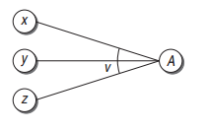
Basic Notation for Cause-Effect Graph
Identity
Not
OR

Slide 40
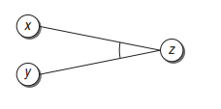

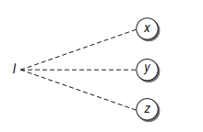
Basic Notation for Cause-Effect Graph
AND
^
Exclusive
Inclusive
Notes:
Exclusive: This constraint exists between causes. It states that either c1 or c2 can be 1, i.e., c1 and c2 cannot be 1 simultaneously.
Inclusive: This constraint exists between causes. It states that atleast one of c1, c2 and c3 must always be 1, i.e., c1, c2 and c3 cannot be 0 simultaneously.

Slide 41

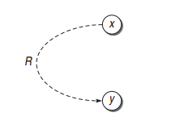
Basic Notation for Cause-Effect Graph
One and Only One
Requires
Notes:
One and Only One constraint or O-constraint: This constraint exists between causes. It states that one and only one of c1 and c2 must be 1.
Requires constraint or R-constraint: This constraint exists between causes. It states that for c1 to be 1, c2 must be 1. It is impossible for c1 to be 1 and c2 to be 0.

Slide 42
Example
The “Print message” is software that reads two characters and, depending on their values, messages is printed.
The first character must be an “A” or a “B”.
The second character must be a digit.
If the first character is an “A” or “B” and the second character is a digit, then the file must be updated.
If the first character is incorrect (not an “A” or “B”), the message X must be printed.
If the second character is incorrect (not a digit), the message Y must be printed.

Slide 43
Identify The Causes and Effects
The Causes of this situation are: C1 – First character is A C2 – First character is B C3 – the Second character is a digit
The Effects (results) for this situation are: E1 – Update the file E2 – Print message “X” E3 – Print message “Y”

Slide 44
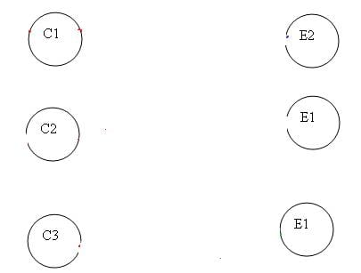
Nodes for Causes And Effects

Slide 45
Understand The Constraints for E1
Effect E1 is for updating the file. The file is updated when – The first character is “A” and the second character is a digit – The first character is “B” and the second character is a digit – The first character can either be “A” or “B” and cannot be both.
Now let’s put these 3 points in symbolic form:
For E1 to be true – the following are the causes: – C1 and C3 should be true – C2 and C3 should be true – C1 and C2 cannot be true together. This means C1 and C2 are mutually exclusive.

Slide 46
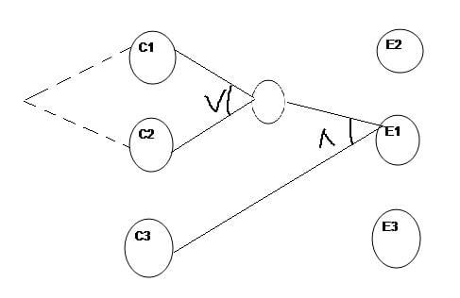
Represent The Constraints in The Graph

Slide 47
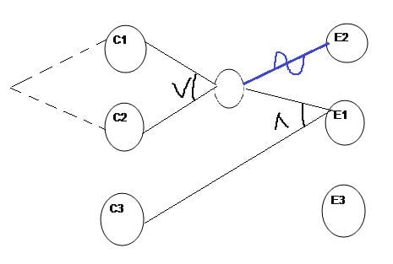
Draw Edges for E2
E2 states print message “X”. Message X will be printed when the First character is neither A nor B. This means Effect E2 will hold true when either C1 OR C2 is invalid. So the graph for Effect E2 is shown as (In blue line)

Slide 48
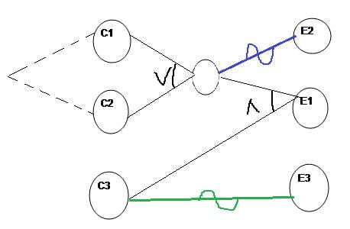
Draw Edges for E3
E3 states print message “Y”. Message Y will be printed when the Second character is incorrect. This means Effect E3 will hold true when C3 is invalid. So the graph for Effect E3 is shown as (In Green line)

Slide 49


Decision Table

Slide 50
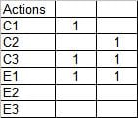
Decision Table
Now for E1 to be “1” (true), we have the below two conditions – C1 AND C3 will be true C2 AND C3 will be true

Slide 51
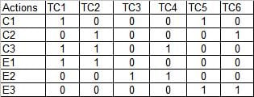
Decision Table

Slide 52
Thank You
END OF CHAPTER

